Slide 1
7
PROJECT NAME
BELANJA YUK
DANI NATSHA HUDAL

Slide 2

Belanja yuk is a web that provides resale item is still feasible to use.

Slide 3
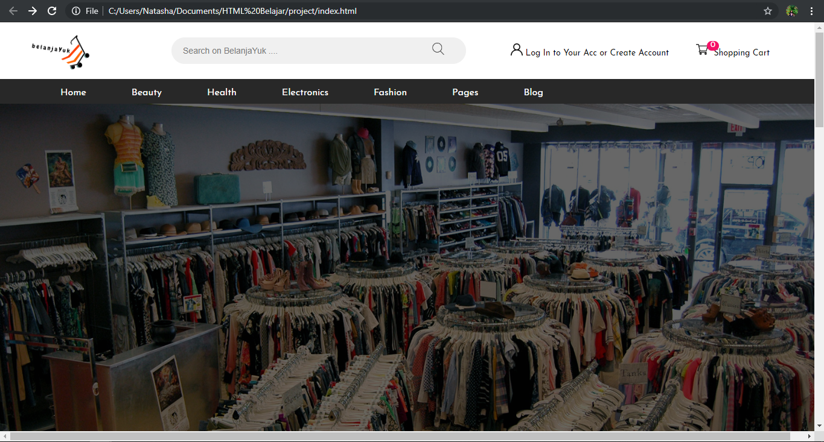
HOME

Slide 4
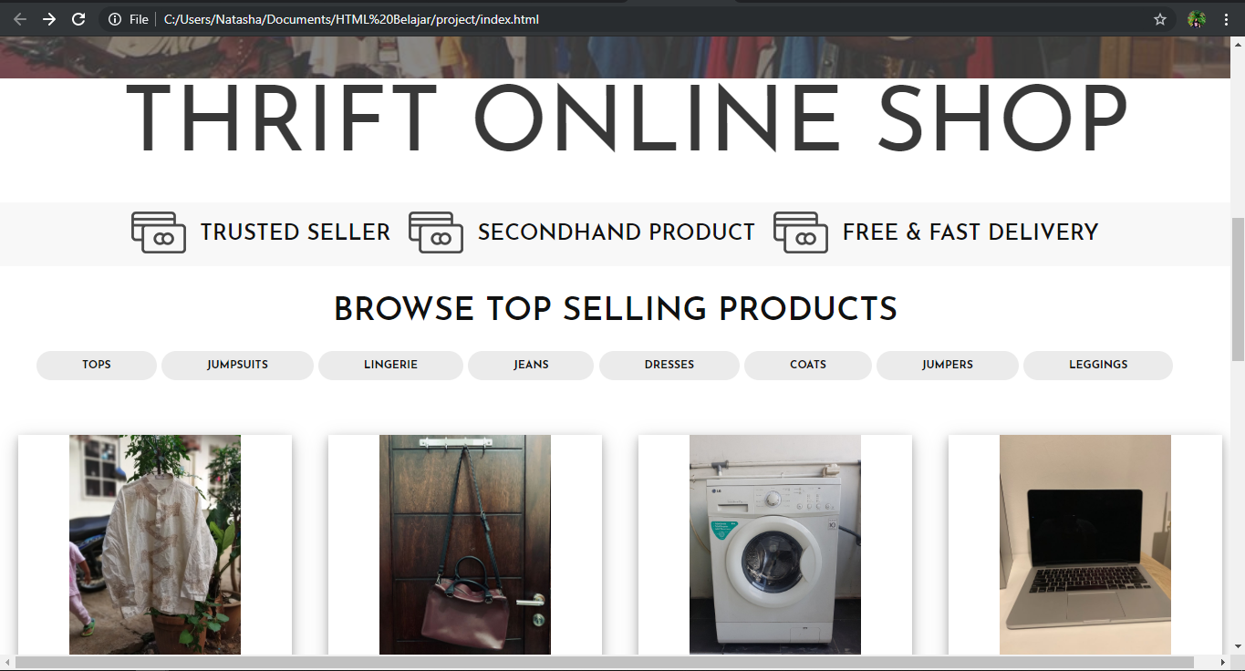
HOME

Slide 5
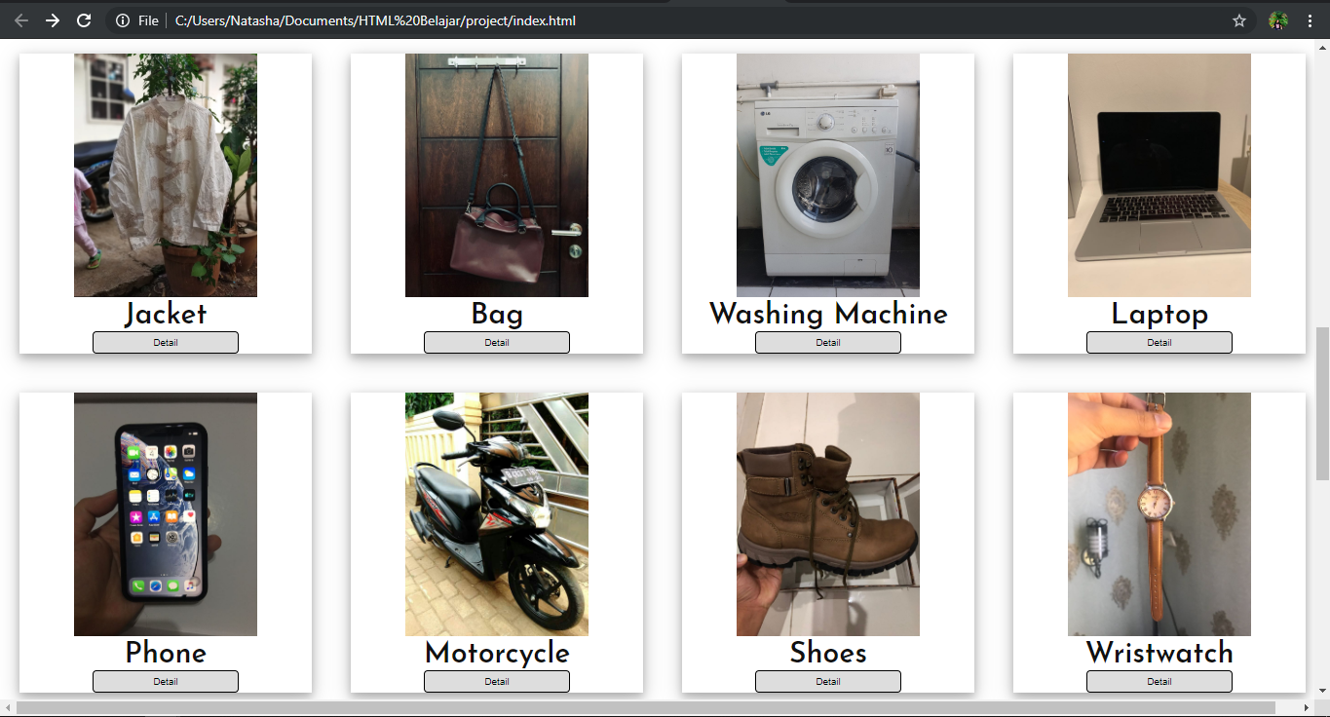
HOME

Slide 6
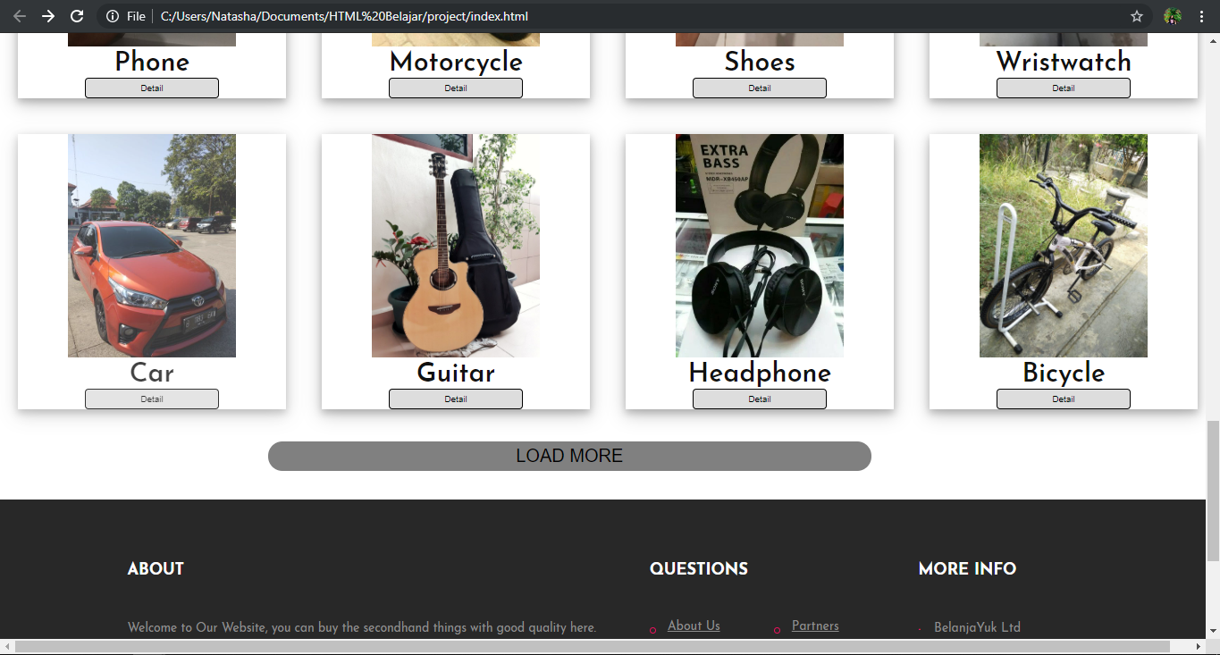

Slide 7
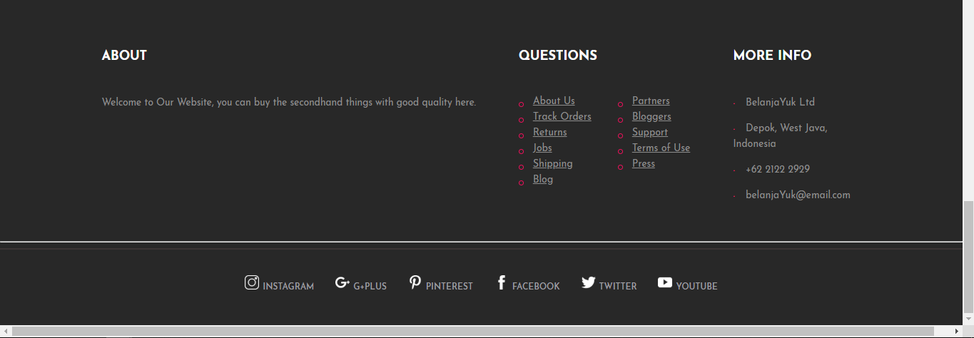

Slide 8
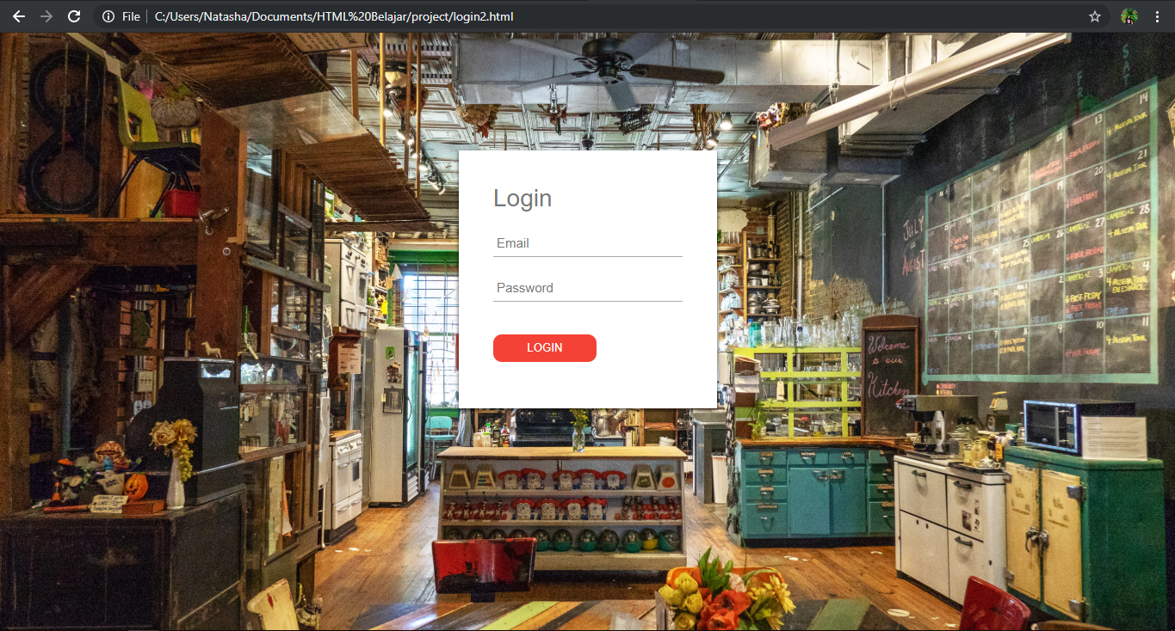
LOGIN

Slide 9
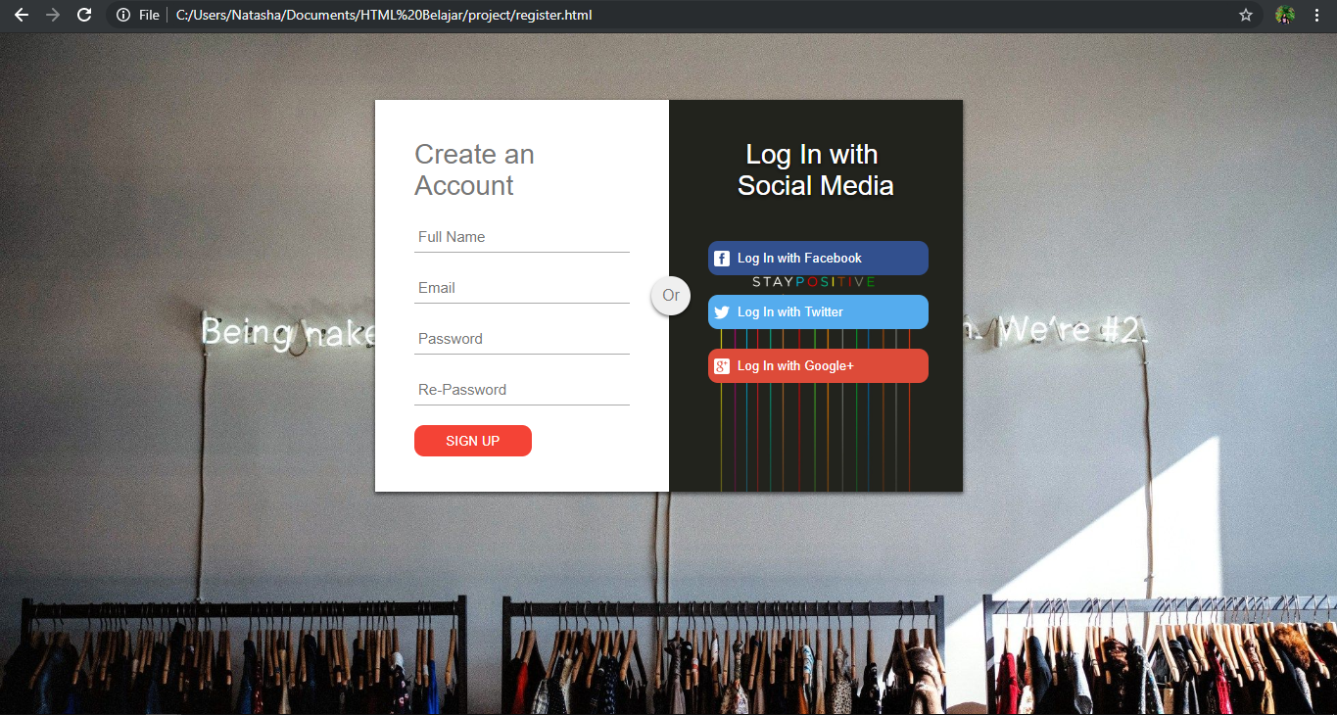
REGISTER

Slide 10
THANK YOU ☺

